Slide 1
Case study – student data
Prepared by:
Tanveer aalam

Slide 2
Contents
Course duration of students over specific days of week
Course duration of students over recorded months
Most active students with respect to duration
Performance of the courses and their durations
Schools and grades effect over the given courses
Login events of different students
Business suggestions for growth of platform

Slide 3
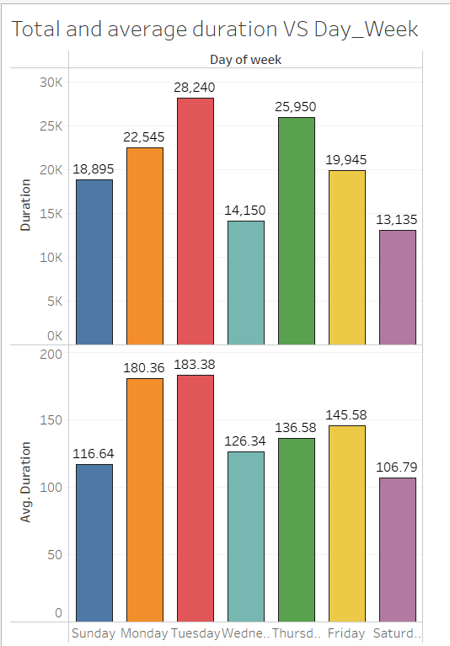
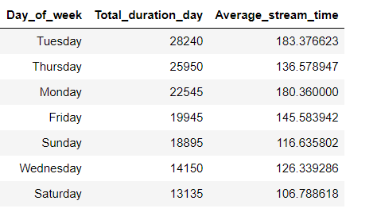
From the analyzed data, it could be seen that students tend to watch the courses more on weekdays (Monday, Tuesday, Thursday) while the watch-minutes have been on the lower side on weekends( Friday, Saturday, Sunday)

Slide 4
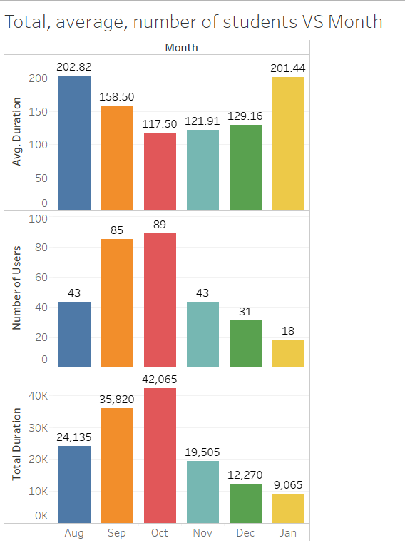
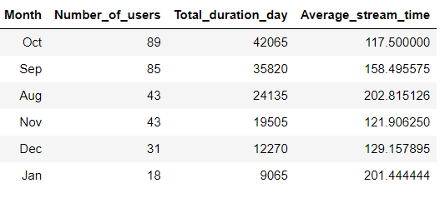
From the below charts and data, The total as well as average watch-minutes have been on higher side for months like October, September, august. On the flip-side as the year progressed, the watch-hours have been gradually decreasing with January of next year being the lowest.

Slide 5
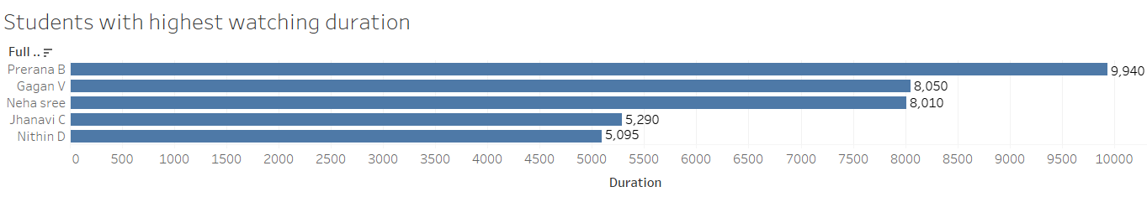
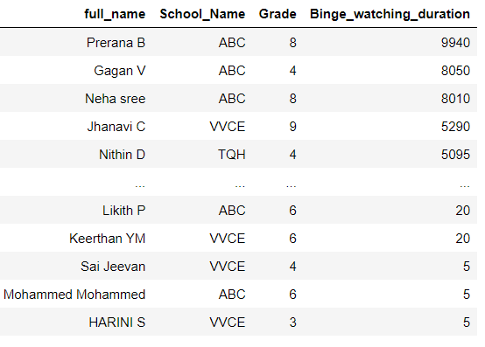
Students like prerana, gagan, Neha Shree have been active on the learning platform with their total watch-minutes being 9940, 8050, 8010 minutes respectively over the months. But there are few students like Mohammed, Harini, Jeevan who are not so active with activity of just 5 minutes on the platform.

Slide 6
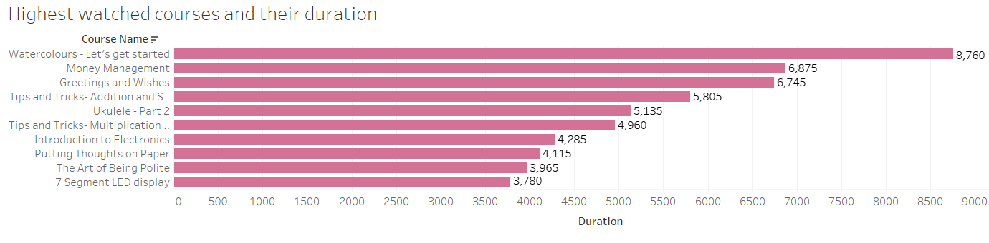
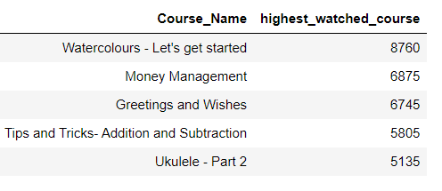
courses like watercolors – let’s get started, money management, greetings and wishes have been among the students’ favorite courses with their watch-minutes being 8760, 6875, 6745 respectively.

Slide 7
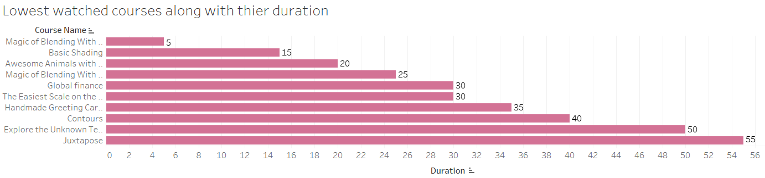
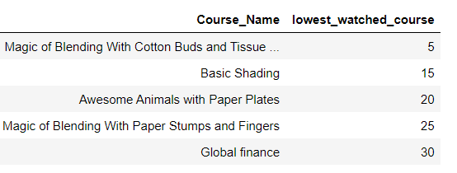
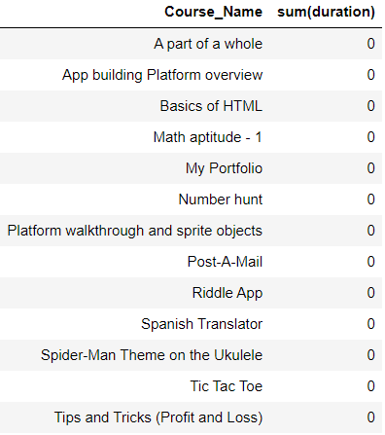
Courses like magic of blending, basic shading, awesome animals have been among the least watched courses. And students tend to ignore courses like a part of whole, basic of html, math aptitude etc. without even opening the course and watching the content in it, with 0 minutes of duration being watched.

Slide 8
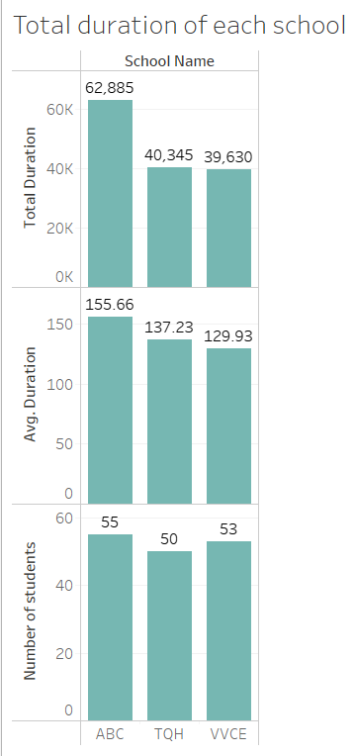
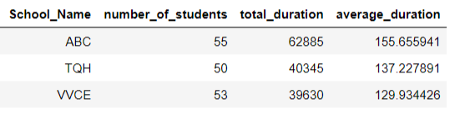
Students from school – ABC are consuming higher duration of content while school – vvce students’ are ranked last among 3 schools with total duration and average duration of watch-minutes being lesser than the other 2.

Slide 9
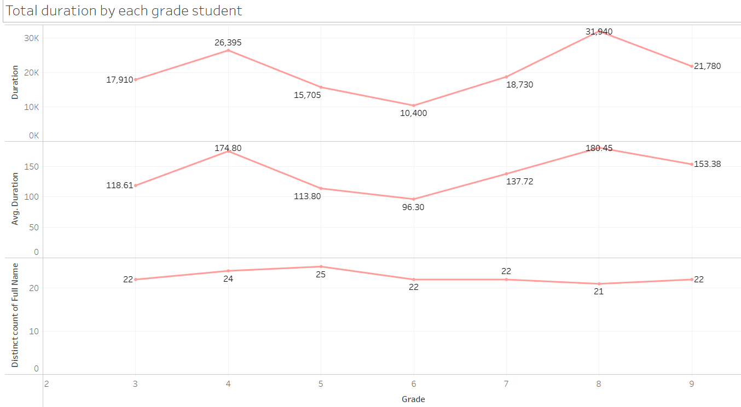
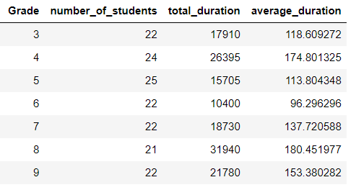
From the graph and data, it is evident that students from grade – 8 are higher consumers of the platform’s content followed by grade – 4, while grade – 6 and grade – 3 students spend lesser amount of time watching the content.

Slide 10
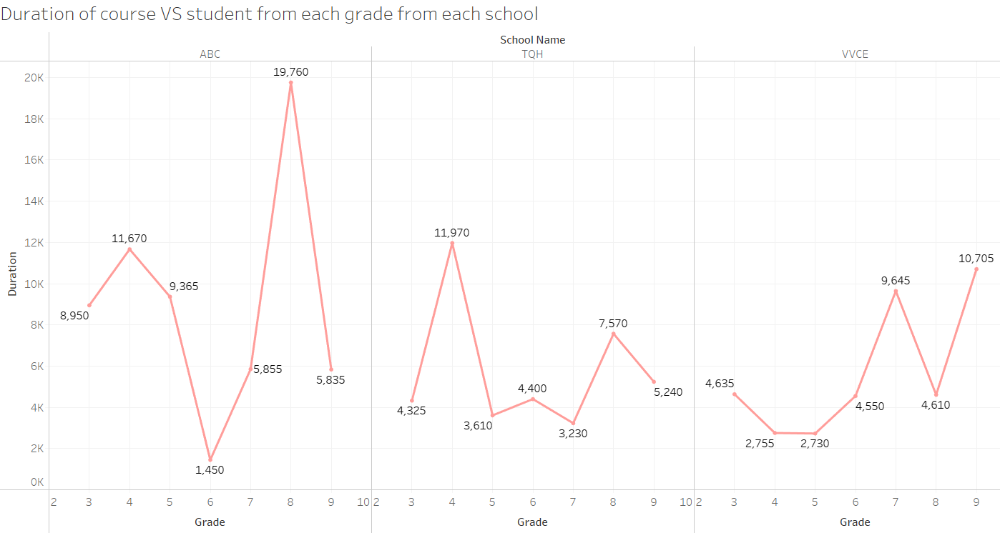
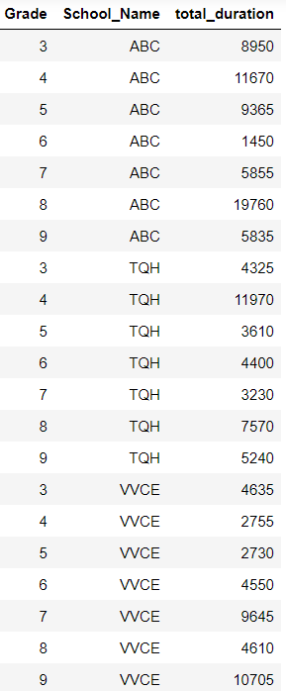
The below graph and data shows the consuming duration of the content from each school by each grade students respectively.

Slide 11
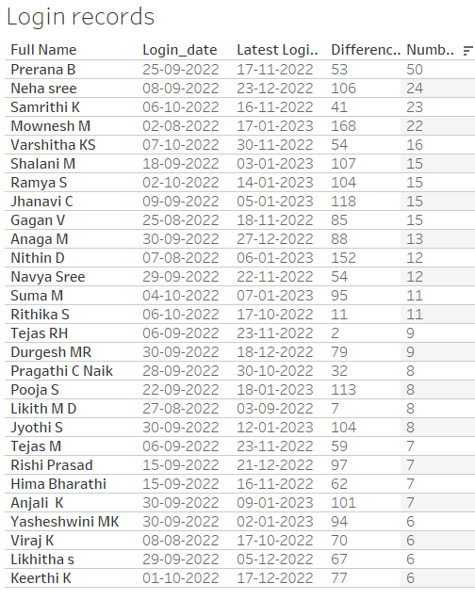
Below are some of the loyal consumers of the platforms with regular logins and higher watch-hours. the last column shows how many times the students have logged into the platform to watch the content available on platform.

Slide 12

It has to be noted that there are few records where students with two different names have been registered under single user_id with the student’s first-name being the same but last-name being different. There have been 8 such records from the dataset provided.

Slide 13
Suggestions for growth in business
Weekends like Friday, Saturday and Sunday has been among the lowest content consumed. To improve the situation, we could ask the schools to make the students participate in different themes available in the platform like art, craft, music, yoga, dance etc. so that the students take out their time of regular learnings.
To improve the depleting situation over past few months, we could release a survey to the parents to know what’s they like and what they additional things they need for their kids. Also, we could release new offers like discounts or referral code to increase users.
There are some weak performing courses available on the platform, we need to re-check the content and probably add some gamification sections which would attract the kids with more interactive questions in between courses.
The students from grade – 4 to grade – 7 have been on the lower side with respect to content consumed. We would either reach out to the schools or conduct a survey for those students for areas of improvement.
Introduction of new activities like in-app rewards, daily activities and tasks for grade specific students, new gamification courses with more hands-on learning makes the students as well as parents to use the platform more.

Slide 14
Thank you

